Slide 1
Application of Augmented Reality in Industry
Aakash Roy, 2nd Year, M. Sc-Ph.D, IEOR
Roll No: 21i190007
Guide: Prof. Jayendran Venkateswaran

Slide 2
Contents
Timeline
What is AR?
Major Industrial Problems
Proposed ideas
Working Procedure
The 5G future
Demo
References

Slide 3
Timeline
Literature Review
Development
Final Demo

Slide 4
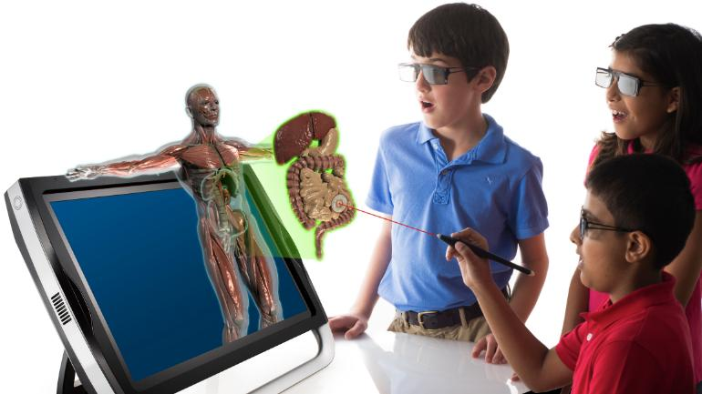
What is Augmented Reality(AR)?
Virtual objects in real life thanks to see-through head-mounted devices.
Fully digitalized world in the real world.
Mainly has two components – a. Software and b. Hardware.

Slide 5
Industrial Problems Where AR is useful
Training & Upskilling Leveraging AR solutions to solve manufacturing training and upskilling challenges benefits businesses and workers at all levels.
Digital Work Instructions AR work instructions guide workers through standardized processes. Instead of a worker reading about three actions at once with only one picture to demonstrate it.
Ergonomics Because augmented reality displays digital overlays onto the surfaces around you, it can adapt to your needs
Manual Process Data & Analytics The rise of automation also led to a rise in available process data. However, manual processes are still relevant and manufacturers rarely aggregate any new data from them. Augmentation makes both processes work together.

Slide 6
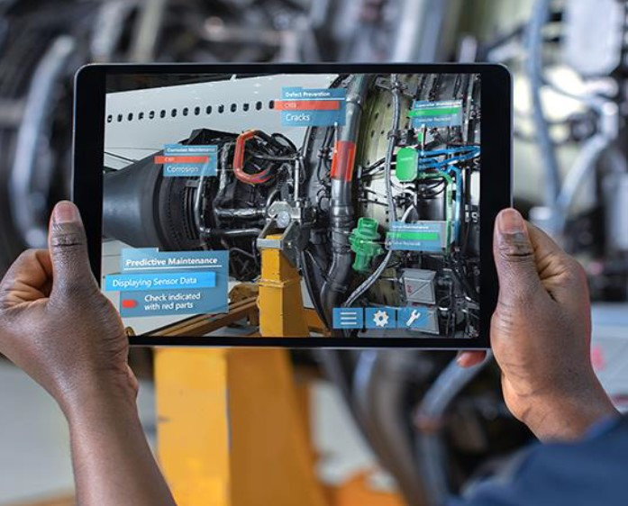
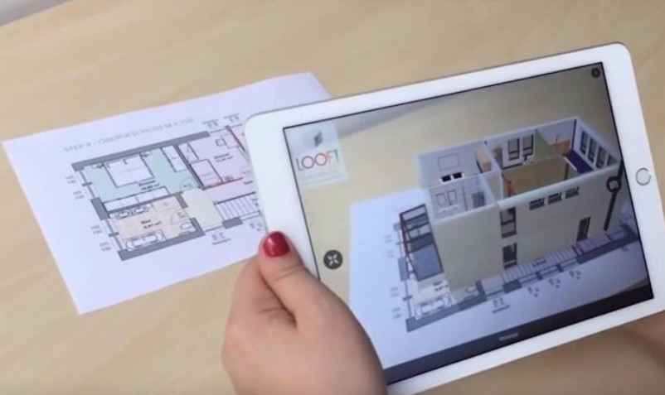
Ideas Proposed
AR Informer The user scans the QR code on the machinery, it redirects it to the data that has been stored into the server and retrieve the AR Statistics/details of that and shows that as AR. It actually helps to know about details of the machines as well their state details easily and decisions can be taken based on that. If things can be polished bit more, everything can be shown in real-time.
AR Model Viewer A program such that it'll scan any hand-drawn model or the corresponding QR code of that and will generate or simulate the hand-drawn model into AR. It can be used in books for students to perform any simulation or to better understand any model. If we can keep the options to change certain parameters, while simulating the models, it’ll be informative as well.

Slide 7
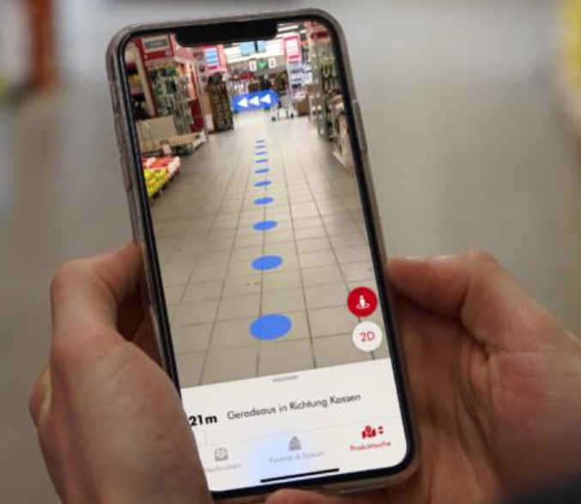
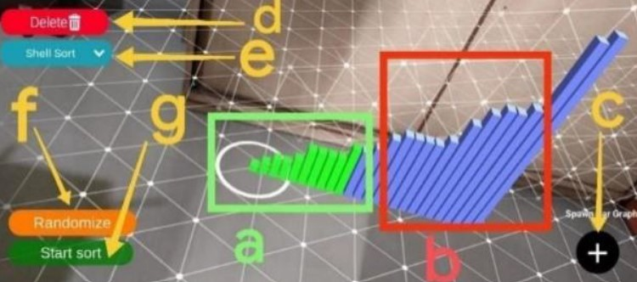
Ideas Proposed
AR Finder we can create an application, that not only tells you which location contains the spare part, but also can navigate you to that optimal location in the least possible time using AR based navigation.
AR Based Algorithm Visualizer when it comes to optimization problems, or heuristics used in operations research, it is difficult for students to understand and look through each iteration. So, if we can generate a framework that can express each iteration into 3D AR, then, this will help students to boost their intuitive power and understanding of the beauty of the algorithms.

Slide 8


Working Procedure
3D Object (glb, gltf format..)
Google Web XR API : Detects the surfaces around and creates a virtual world on top of the real world
3D objects are placed to viewing!

Slide 9
The 5G Future
Broadly speaking, 5G is used across three main types of connected services, including enhanced mobile broadband, mission-critical communications, and the massive IoT. A defining capability of 5G is that it is designed for forward compatibility—the ability to flexibly support future services that are unknown today. Enhanced mobile broadband In addition to making our smartphones better, 5G mobile technology can usher in new immersive experiences such as VR and AR with faster, more uniform data rates, lower latency, and lower cost-per-bit. Mission-critical communications 5G can enable new services that can transform industries with ultra-reliable, available, low-latency links like remote control of critical infrastructure, vehicles, and medical procedures. Massive IoT 5G is meant to seamlessly connect a massive number of embedded sensors in virtually everything through the ability to scale down in data rates, power, and mobility—providing extremely lean and low-cost connectivity solutions.

Slide 10

Demo
First connect to IITB.AR, it’s open
Scan the QR code in the right side >>
A link will open that will have option to proceed advance
Click there
Click on enter the AR world
Move your device above around the surface as shown
One circle will start floating on the surface.
Click on the circle., ready to go..

Slide 11
References
Siltanen, S. Texture generation over the marker area. In Proceedings of the ISMAR 2006: Fifth IEEE and ACM International Symposium on Mixed and Augmented Reality, Santa Barbara, CA, USA, 22–25 October 2006; pp. 253–254.
Mur-Artal, R.; Montiel, J.M.M.; Tardos, J.D. ORB-SLAM: A Versatile and Accurate Monocular SLAM System. IEEE Trans. Robot. 2015, 31, 1147–1163
Meta Official Website. Available online: Click Here (accessed on 7 November 2020).
Augmented Reality in Industry 4.0 and Future Innovation Programs’, Gian Maria Santi, Alessandro Ceruti, Alfredo Liverani and Francesco Osti
‘AR-Based Algorithm Visualizer’, Dr. Arvind Bhagat Patil, Aditya Khadse, Swaraj Wankhade, Sankalp Chake, Anmoldeep Singh Arora
https://www.automationworld.com/factory/plant-maintenance/article/21205097/augmented-reality-gets-to-work
https://www.ptc.com/en/technologies/augmented-reality
https://www.archdaily.com/914501/9-augmented-reality-technologies-for-architecture-and-construction/5ca75ab9284dd1e433000252-9-augmented-reality-technologies-for-architecture-and-construction-photo?next_project=no
https://www.locandis.de/ar-navigation-indoor-navigation-von-locandis-jetzt-mit-augmented-reality-funktion/

Slide 12
Thanks !!

